Slide 1

Current Services
Currently patients in Warrington have the opportunity to access two types of Extended Access Services outside of core General Practice hours (08:00-18:30):
CCG commissioned Extended Access
  currently delivered by Quay Healthcare CIC from Bath Street Health and Wellbeing Centre on Legh Street
  available at evenings and weekends
2. NHS England commissioned Extended Hours Access
  currently delivered from GP Practices to all registered patients within their respective PCN
  available at evenings, weekends and early mornings

Slide 2
Why is this changing?
The NHS has been changing a lot recently, with new initiatives and organisations being developed by the Government.
With the national developments of Primary Care Networks, the funding and responsibility for Extended Access must transfer from the CCG to the PCNs by October 2022.
The new offer is based on PCNs providing bookable appointments outside core hours, utilising the full multi-disciplinary team, and offering a range of general practice services, including ‘routine’ services such as screening, vaccinations and health checks, in line with patient preference and need.”

Slide 3
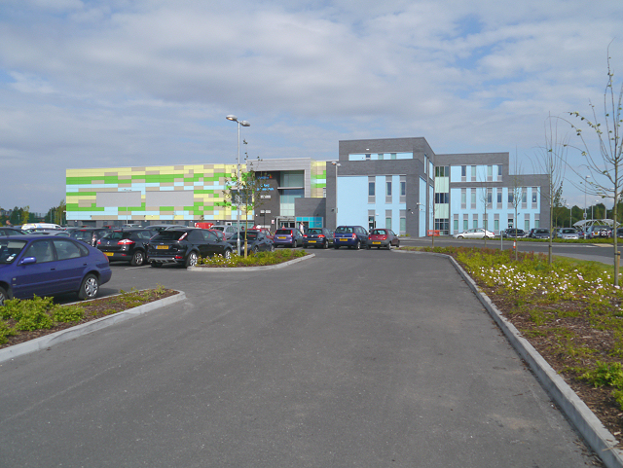
Collaborative PCN Proposal
The Collaborative PCN, is four PCNs across Warrington working together to deliver Extended Access Services.
Pilot service since August 2021
Hub & Spoke model (Orford Jubilee and GP locations across the town)
498 (97%) positive comments from people who have used the service during the pilot
Central location
Accessible
This Photo by Unknown Author is licensed under CC BY-SA

Slide 4




Proposed Model
Collaborative PCN Proposal
All collaboration networks
South Warrington Network
East and Central East Networks
Warrington Innovation Network
 | 4 Seasons Medical Centre | Parkview Medical Centre | Latchford Medical Centre | Stockton Heath Medical Centre | 1 Manchester Road | Orford Jubilee Hub
Monday | 6.30pm – 8pm |  | 6.30pm – 8pm |  | 6.30pm – 8pm
Tuesday | 6.30pm – 8pm |  | 6.30pm – 8pm |  | 6.30pm – 8pm
Wednesday |  | 6.30pm – 8pm |  | 6.30pm – 8pm | 6.30pm – 8pm
Thursday | 6.30pm – 8pm |  |  | 6.30pm – 8pm | 6.30pm – 8pm
Friday |  |  |  |  |  | 6.30pm – 8pm
Saturday |  |  |  |  |  | 8am-4pm
Sunday |  |  |  |  |  | 10am-2pm

Slide 5
Your views matter!
We are looking for your views on the new Enhanced Service and a formal 12 week public consultation is now underway, between Tuesday 3rd May – Sunday 26th July 2022.
You can contact the Collaborative PCN with your feedback via:
warccgextaccesscic@nhs.net
You can also contact NHS Warrington CCG, who are supporting PCNs, to give your comments via email or telephone, below:
warccg.halccg.commseng@nhs.net
01925 30 30 30
More information can be found on the CCG website
www.haltonwarringtonccg.nhs.uk

Slide 6
Where can you find us next?
We are hosting drop in sessions at the spoke sites whilst the consultation is running between Tuesday 3rd May – Sunday 26th July 2022.
Our next one is:
Saturday 28th May - 1st Floor Orford Jubilee, between 10am and 12noon

